Slide 1


CLUSTERING
Auto Labeling
Cyberbullying in YouTube Comments
Notes:
Hello everyone, I'm Hung. Today, I will present the project of Clustering & Automatically Labeling Cyberbullying in Youtube Comments.

Slide 2
Table of contents
Problem & Objective
Dataset & Preprocessing
Feature Extraction
Dimensionality Reduction
5. Data Visualization
6. K-means & Bert Topic
7. Hyperparameter Tuning
8. Evaluation & Prediction
Notes:
We will go through 8 sections, including

Slide 3
Problem and objective
Cyberbullying is a serious and growing problem on social media. However, detection and prevention are difficult because supervised learning methods require large amounts of labeled data. Collecting and labeling this data is time-consuming, expensive, and may not keep up with changing forms of cyberbullying.
Therefore, we propose to apply text clustering and automatic labeling methods, which help to classify and analyze large amounts of data effectively.
Notes:
First of all, we need to define the problem and objective.

Slide 4
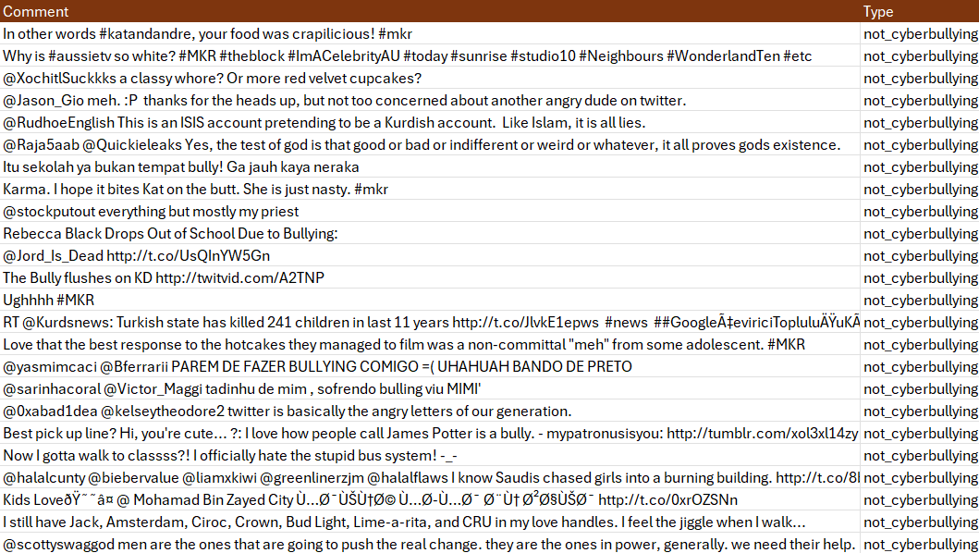
Dataset
Raw data: 5000 multi-sentence comments crawled and synthesized from 10 YouTube videos with diverse topics
Cleaned data: 10000 single sentences preprocessed from irrelevant comments, noise,...
Training and testing data: Split 80-20
Notes:
My dataset is scraped and synthesized from 10 YouTube videos with diverse topics. After filtering and cleaning, 10000 data will be used for training and testing in an 80-20 ratio.

Slide 5
Data Preprocessing
They are bad bullies, 该死的 😠!
Clean text
They are bad bullies, 该死的
Tokenize
They
are
bad
bullies
该死的
Remove non-English words
X
They
are
bad
bullies
Remove stopwords
X
They
X
bad
bullies
Lemmatize
X
They
X
bad
bully
Notes:
To ensure data quality, I applied 6 preprocessing steps. They are...

Slide 6
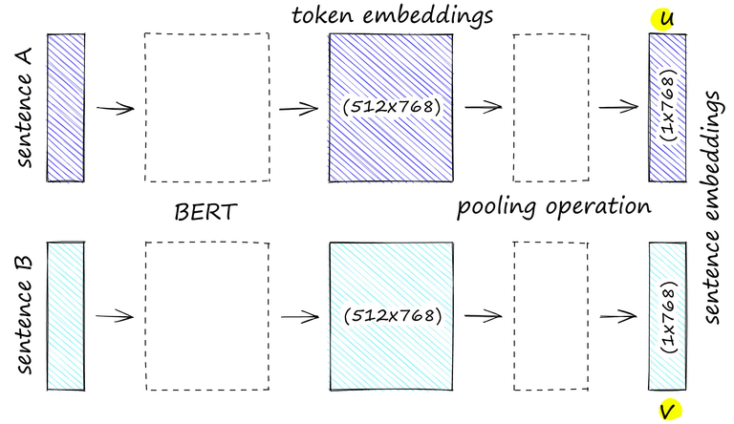
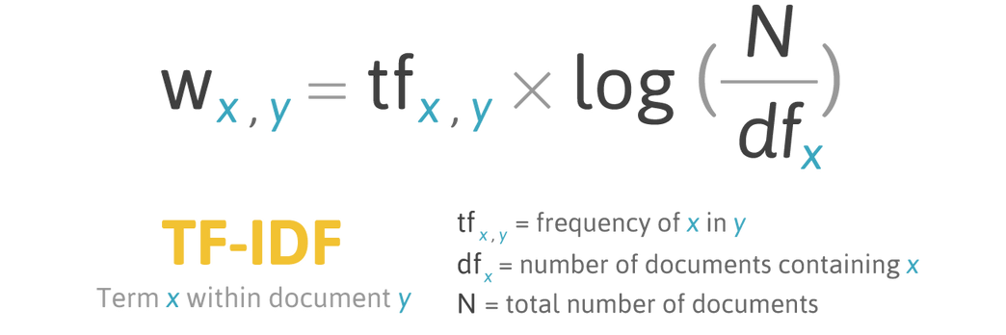
Feature Extraction (Embedding)
TF-IDF
SENTENCE TRANSFORMER
< 5%
SBERT use siamese and triplet network structures to derive semantically meaningful sentence embeddings.
Notes:
Next, I will extract features from the data using Term Frequency-Inverse Document Frequency and SBERT. By using siamese and triplet network structures to derive semantically meaningful sentence embeddings, SBERT gives 5% better performance.

Slide 7
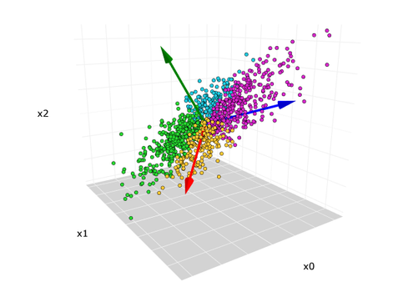
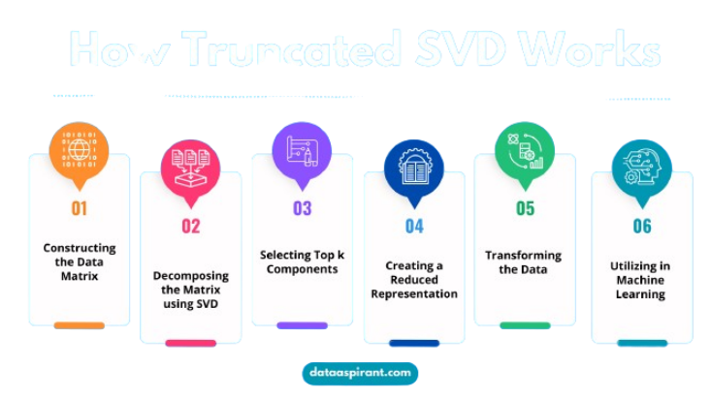
Dimensionality Reduction
PCA
TRUNCATED SVD
< 3%
The input data is centered but not scaled for each feature before applying the SVD.
Do not center the data before computing singular value decomposition to work efficiently with sparse matrices.
Notes:
In the data dimensionality reduction step, truncated SVD is the winner with 3% higher performance. In PCA, the input data...

Slide 8
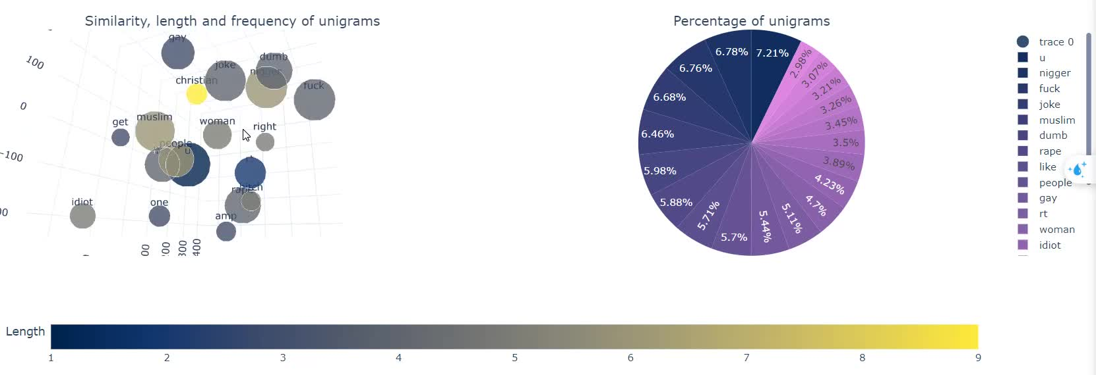
Data Visualization (unigram)
Visualize and analyze data to identify features and correlations in high-dimensional space. Our target is to minimize the distance between relevant data and vice versa.
Notes:
Furthermore, we will...

Slide 9
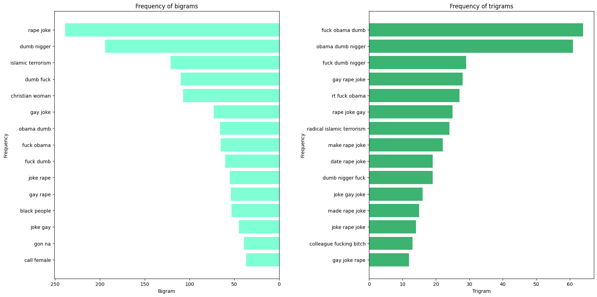
Data Visualization (n-gram)
Detect keywords that account for a high proportion of the data
and issues such as data imbalance, inconsistency data, noise,...
Notes:
Not only unigrams but I also visualize n-grams like bigrams and trigrams to detect...

Slide 10
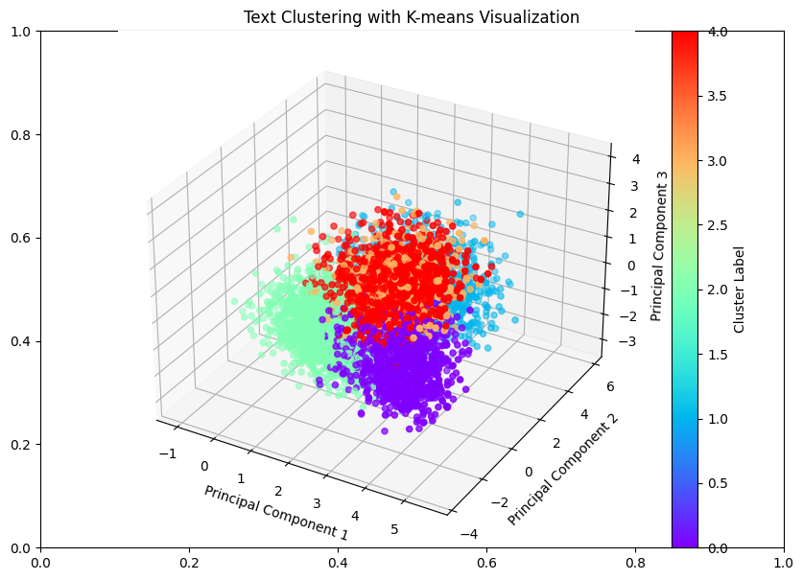
K-means and Fuzzy C-means
Traditional machine-learning algorithms
Fast but not furious
Not suitable for:
Data without clear separation
Imbalanced data
High-dimensional data as text
Sensitive to the initial K value and noisy data
Notes:
And now comes the most important part, training the model. First, we will cluster the data using traditional machine-learning algorithms. These models are fast...

Slide 11
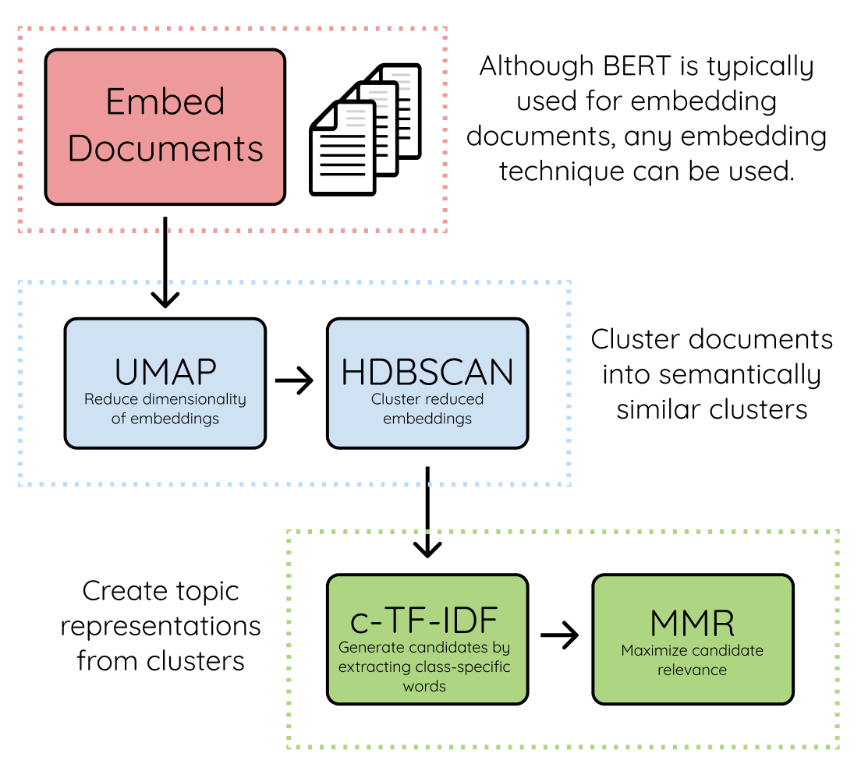
Bert Topic
Understand the context and complex semantic relationships in text
No need to declare the number of initial clusters
Able to cluster topics with high overlap and ambiguity
Able to cluster data hierarchically, identify keywords and representative documents
Enable to manually adjust, merge, and split clusters after training
Notes:
So what model can solve those weaknesses? It is Bert Topic. It can...

Slide 12
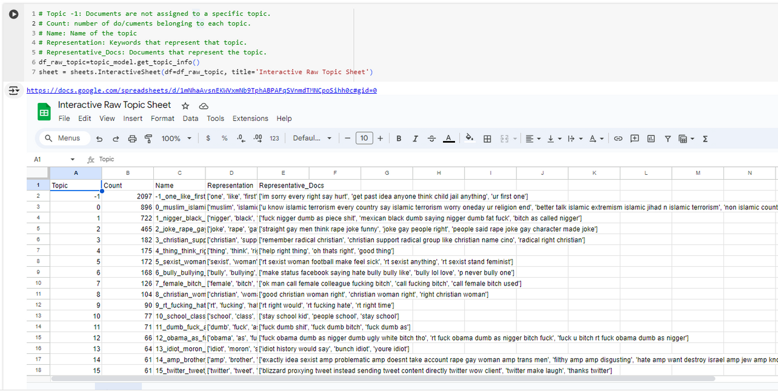
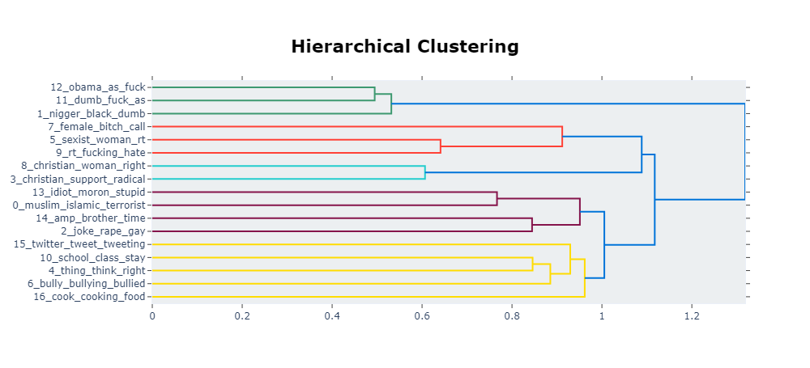
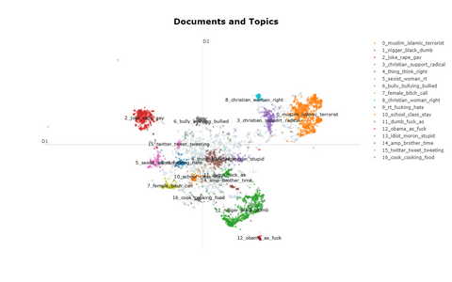
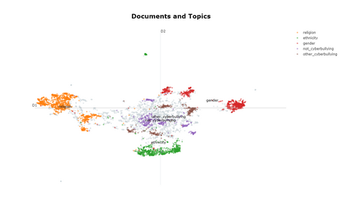
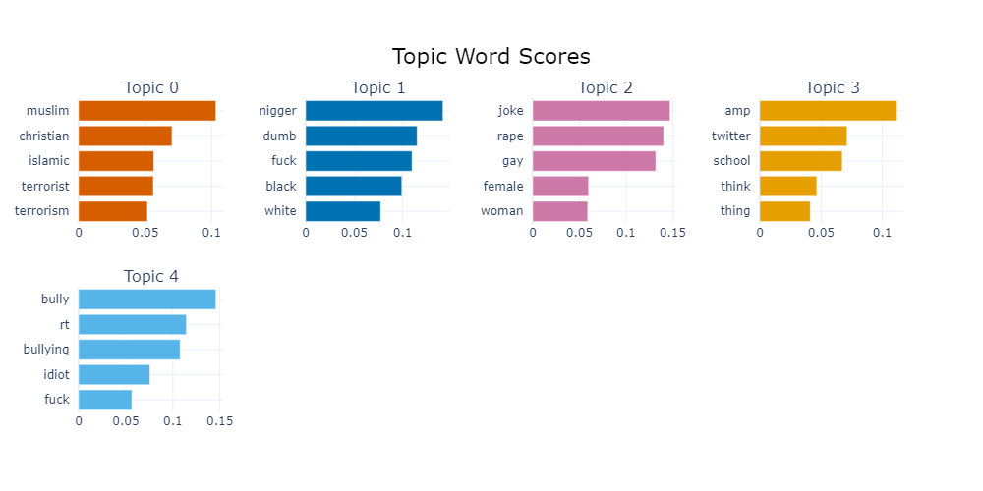
Bert Topic
1. Explore keywords and representative docs of clustered topics
2. Analyze the hierarchical relationship between topics
3. Merge related and duplicate topics
4. Name topics based on common keywords
Notes:
Let's take a look at how the model allows us to enhance the results by merging the topics. First, we will...

Slide 13
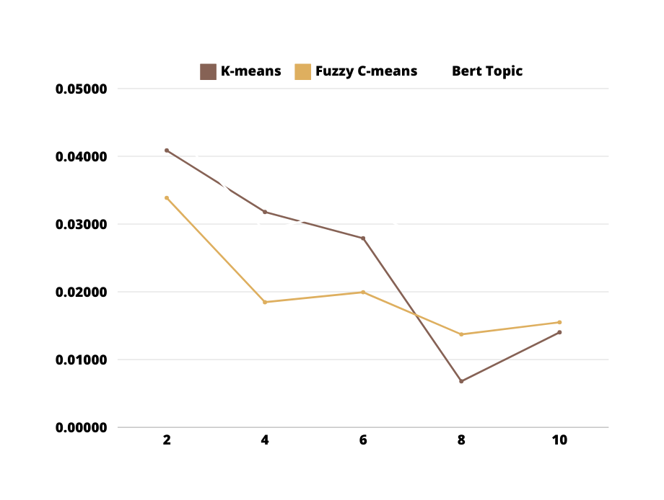
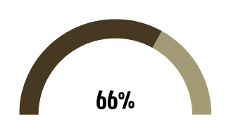
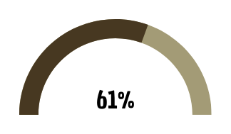
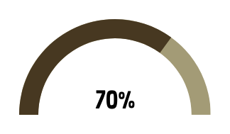
Hyperparameter Tuning & Evaluation
Silhouette scores by number of clusters
Accuracy scores
K-means
Fuzzy C-means
Bert Topic
Notes:
The silhouette score ranges from -1 to 1, high scores indicating the model separates clusters well.
In this dataset, to balance between diversity and accuracy, I chose the number of clusters to be 5 or 6.
As you can see, Bert Topic gives outstanding accuracy up to 70%.
*1: Ideally close data points within a cluster and far away from other clusters (good clustering).
0: Data points are on the border between clusters, indicating some overlap (average clustering).
-1: Data points might be assigned to the wrong cluster (poor clustering).*

Slide 14
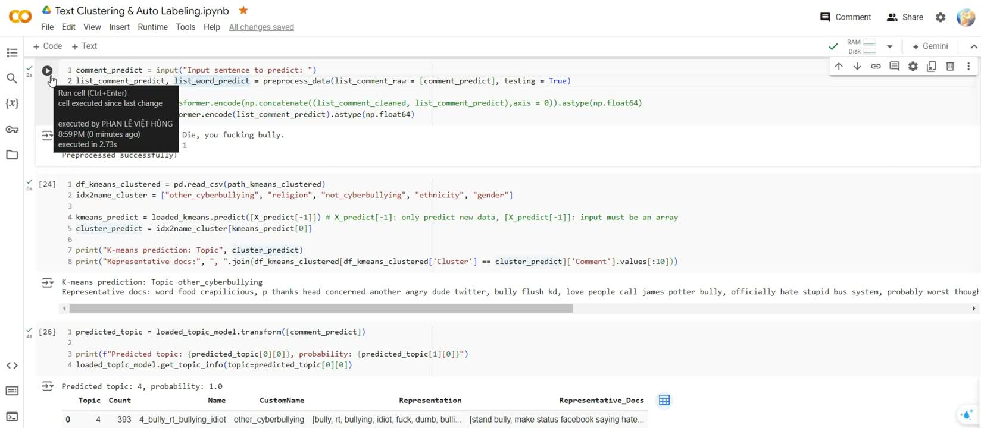
Prediction
Notes:
To verify these score, I will do a little experiment:
While Kmeans predicted incorrectly the first sentence, Bert Topic predicted all three sentences correctly.

Slide 15
Summary
Automatic clustering and labeling is a potential method for problems with time-varying labels like cyberbullying, which can save time and cost of labeling data.
Bert Topic is a state-of-the-art model. It can:
Understand the complex context and semantic relationships in text
Identify keywords and representative documents
Topic merging and hierarchical clustering
Performance and accuracy need to be improved by selectively expanding and enhancing the quality of the dataset
Notes:
Before concluding my presentation, let me recap a few key points.

Slide 16

THANK YOU
For Listening
If you have any questions, please ask me.
Notes:
Well, that is all I have for today. Thank you for listening. If you have any question

